Slide 1
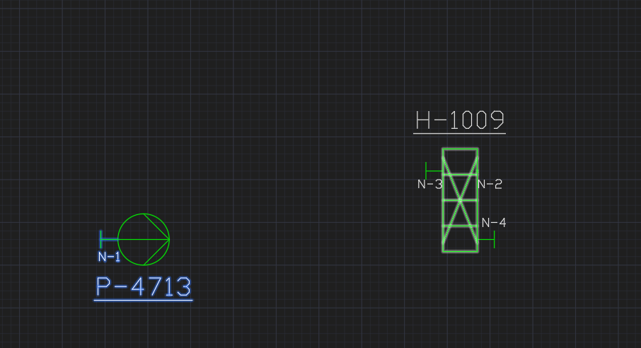
E05V01 Pump and HeatExchanger, with Nozzles

